Slide 1
Peterson’s Solution.
Govinda Jamakatel

Slide 2
What is peterson’s solution?
It is the classic software-based solution to the critical-section problem.
May not work correctly in the modern computer architecture.
It provides the good algorithmic description of solving a critical section problem.
Helps to design a software that needs to have a solution to the critical section problem.
Requirements to solve the critical-section problem are mutual exclusion, bounded waiting and progress.
It takes two processes into the consideration.

Slide 3
Peterson’s solution to solve critical section problem
It takes two processes, let’s say p1 and p2, which shares the common resources.
It takes two data structures, these are Int turn; //Indicates whose turn it is to enter its critical section. Boolean flag[2]; //Indicates if the process is ready to enter its critical section.
The value of turn may be either 1 or 0 specifying that which process’s turn is to enter into critical section.
The value of flag decides which process is interested to enter into the critical section.

Slide 4
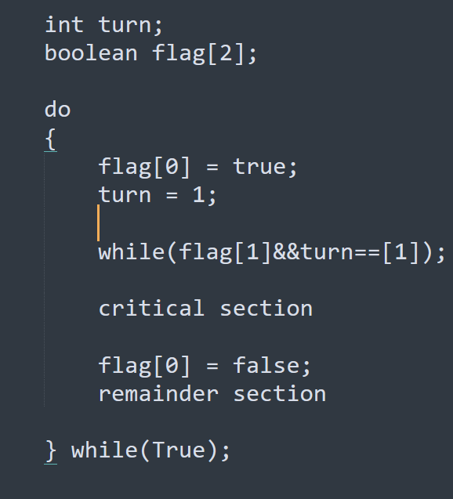
Structure of p1

Slide 5
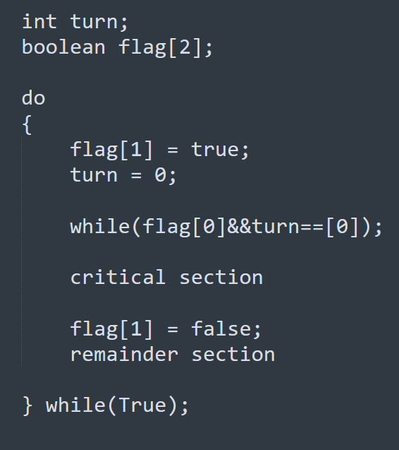
Structure of p2

